Slide 1





Car Dealership Sales Analysis

Slide 2
Total Revenue
R7 606 367 587,00

Slide 3
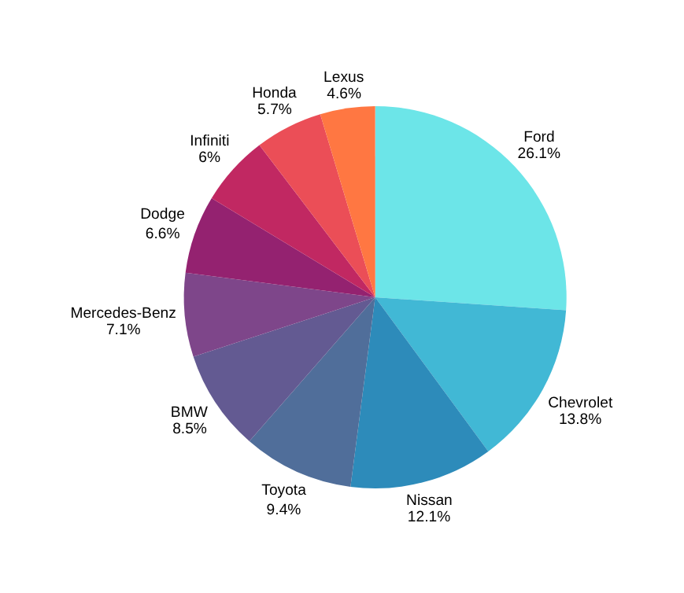
Top 10 Revenue by Make/Model
  Ford leads overall sales revenue with close to 30% , accounting for over a quarter of total car sales.
  Ford’s strong revenue leadership suggests:
High unit sales and/or higher-priced models.
Possibly dominant presence in fleet or financing sales.
  Luxury brands (BMW, Mercedes-Benz, Lexus) together make up ~20% of total revenue — a solid high-value segment despite lower unit volumes.
  Mid-range brands (Toyota, Nissan, Honda, Chevrolet) show balanced revenue, likely due to steady used car demand.
  Revenue distribution shows healthy brand diversity — no single brand overly dominates beyond Ford.

Slide 4
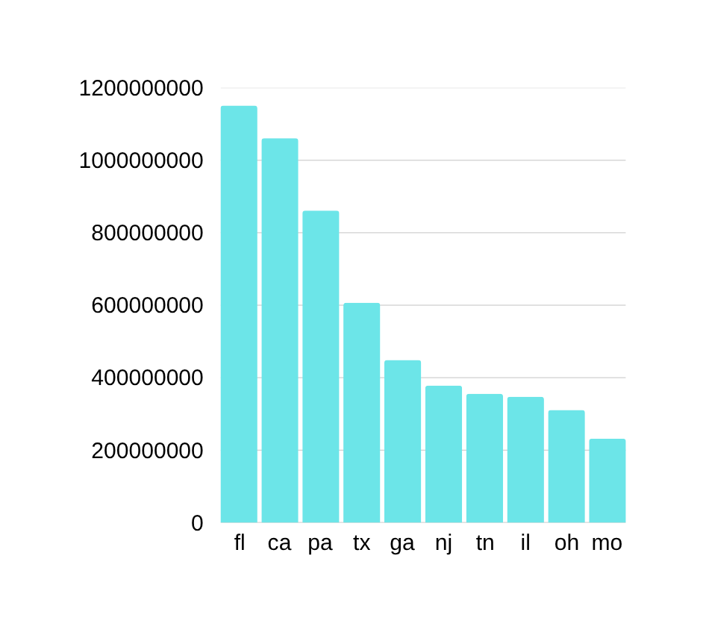
Top 10 : Sales Volume by State
Total Sales: R 5.75 Billion
Top 3 States:
Florida (FL): R 1.15B (~20% of total)
California (CA): R 1.06B (~18%)
Pennsylvania (PA): R 861M (~15%)
Followed by
Midwest states (IL, OH, MO) account for ~15%
Missouri (MO): R 232M (~4%)
Regional Insights:
Southeast states (FL, GA, TN) account for ~34% of total sales
Midwest states (IL, OH, MO) account for ~15%
Observation:
Sales are heavily concentrated in a few key states, with FL, CA, and PA contributing over 50% of total revenue.

Slide 5
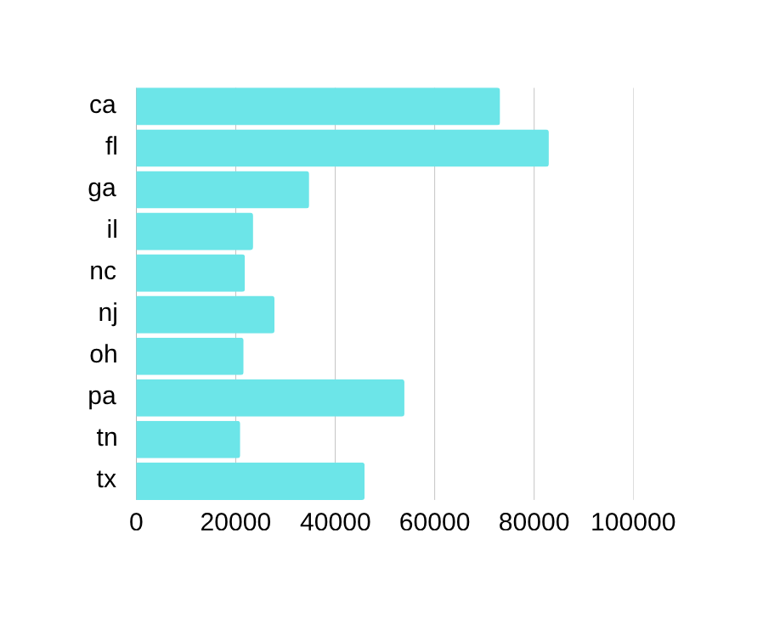
Top 10 : Count of Vehicles Sold
  Top 3 states by volume: FL, CA, PA (~51% of total vehicles sold)
Observation:
  Vehicle count trends largely match revenue trends, confirming FL and CA as key markets.
  Some states like PA and TX have relatively high revenue but moderate volume, suggesting higher average selling prices per vehicle.

Slide 6
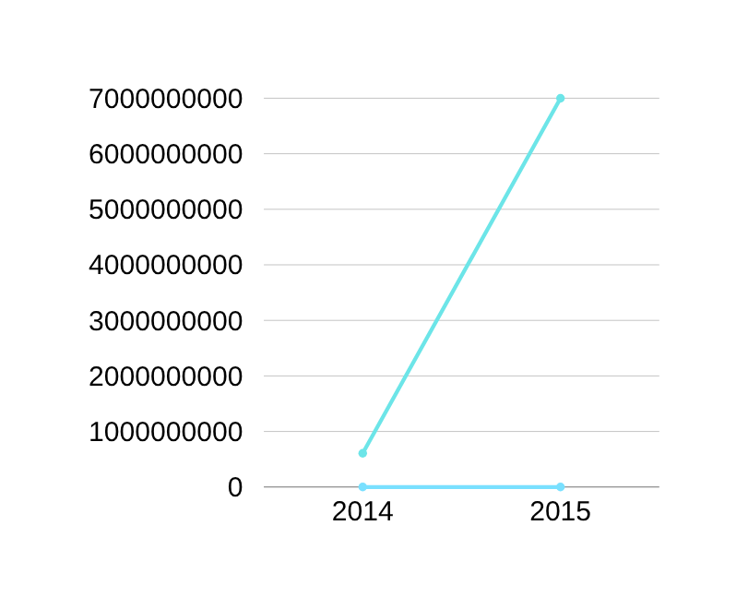
Total Sales by Year
  Massive Growth in 2015:
  Sales jumped from ~R607M in 2014 to ~R6.99B in 2015.
  That’s an increase of over 1,050%—huge year-on-year growth.
  2014 vs 2015 Contribution:
  2014 accounts for ~8% of total sales.
  2015 accounts for ~92% of total sales.
  Observation:
  Likely due to expansion of inventory, market reach, or a new high-selling model.
  2015 was clearly the dominant sales year, driving overall revenue.

Slide 7
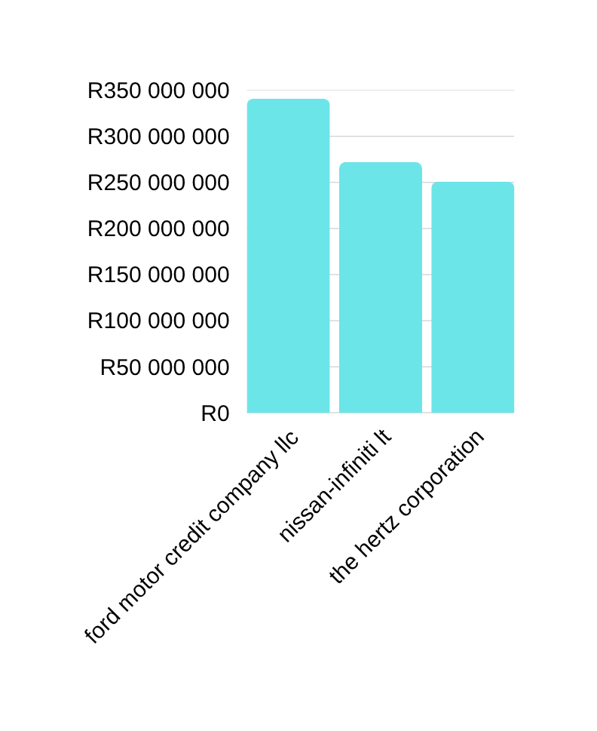
Revenue by Seller
Top Seller:
  Ford Motor Credit Company LLC leads with ~R341M (~39% of total seller sales).
Moderate Performers:
  Nissan-Infiniti LT (~R272M, 31%)
  The Hertz Corporation (~R251M, 29%)
Observation:
  Sales are fairly concentrated among three major sellers, with Ford slightly ahead.
  The distribution suggests opportunities to optimize partnerships or negotiate better terms with these high-performing sellers.

Slide 8
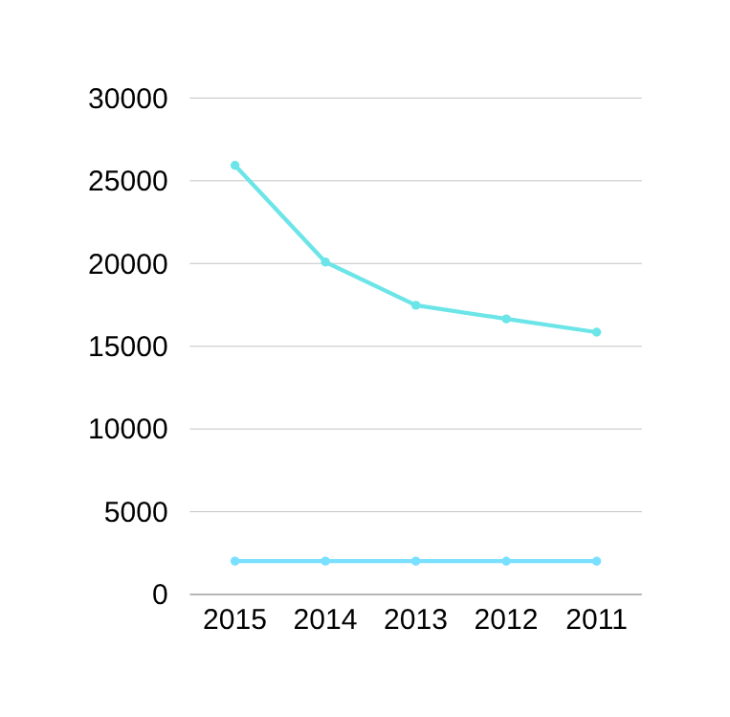
Depreciation Trend
Vehicle age effect:
  As expected, newer model years have higher selling prices, indicating that depreciation strongly influences resale value.
  As model year gets older, average selling price drops sharply — this is a textbook depreciation effect.
  Newer model years command higher prices.
  Price drops as vehicles age, likely due to depreciation.

Slide 9





Recommendations
Focus on High-Performing States
  Prioritize marketing, inventory, and promotions in FL, CA, and PA, which contribute the majority of sales and revenue.
  Use targeted campaigns, loyalty programs, and exclusive offers to retain top customers.
Boost Lower-Performing States
  Target the Lower-Performing States with promotions, dealer incentives, or pop-up sales events.
  Analyze why these states underperform—consider demographic trends, competitor activity, or pricing strategies.
Optimize Inventory by Vehicle Age and Price
  Focus on newer models that command higher average selling prices.
  Maintain a balanced mix of slightly older, popular models to appeal to budget-conscious buyers.
  Align stock levels with state-specific demand and historical sales trends.
Data-Driven Pricing & Promotions
  Monitor average selling price trends and vehicle mileage to adjust pricing competitively.
  Consider bundling services, warranties, or financing offers to increase average revenue per vehicle.
Explore Revenue Growth Opportunities
  Analyze models and regions that generate high revenue but moderate volume (e.g., PA, TX) to identify premium pricing strategies.
  Expand digital marketing and online sales channels to reach new customers efficiently.

Slide 10





Thank You!
Analysis conducted by
T K Ndlovu
info.kylendlovu@gmail.com
+27 69 1414 241

